Slide 1
Regulation of respiration I
Dr.Dulani Kottahachchi
Department of Physiology

Slide 2
Objectives
Describe
Neural
Chemical
Mechanical control of normal quiet breathing
Describe voluntary control of breathing
explain the physiological basis of
breath-holding
hyperventilation

Slide 3
Normal quiet breathing
At rest, breathing is controlled by the need to remove CO₂
Carbon Dioxide Drive
Control of breathing
Neural control of breathing
Chemical control of breathing - Changes in PaO₂, PaCO₂ and [H⁺] (arterial blood gases)
Mechanical control of breathing -Changes in pressure & volume (tissue deformation)

Slide 4
Normally unaware of breathing – involuntary
But breathing can be changed voluntarily by influence from the cortex; e.g during
speech
hyperventilation
breath holding
involuntary acts: swallowing, sneezing, coughing, vomiting

Slide 5
Homeostasis principle
Receptors - Chemorecptors/Pulmonary receptors
control centres – brainstem(Medulla/pons) /cortex
Effectors – respiratory muscles

Slide 6
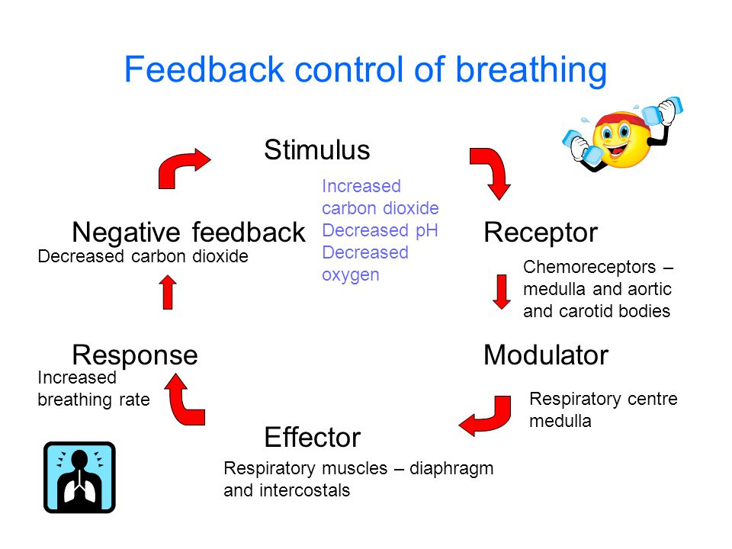

Slide 7
Neural control of breathing
Respiratory rhythm is generated by the “respiratory centres” in the medulla oblongata
Initiated by a small group of pacemaker cells in the pre-Botzinger complex
Dorsal respiratory group (inspiratory neurons)
Ventral respiratory group (inspiratory and expiratory neurons)
Modified by the pneumotaxic centre in the pons
Pneumotaxic centre is influenced by the cerebral cortex and hypothalamus

Slide 8
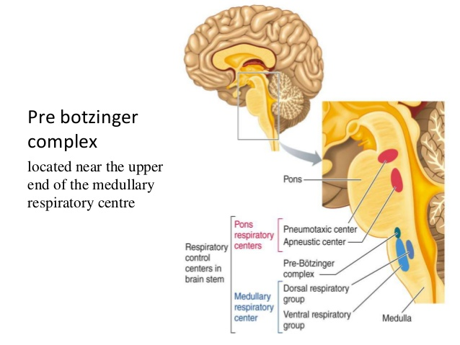

Slide 9
DRG -Inspiratory neurons discharge action potentials during inspiration
VRG -Expiratory neurons are quiet during normal breathing, as expiration is passive; active only with increased ventilation

Slide 10
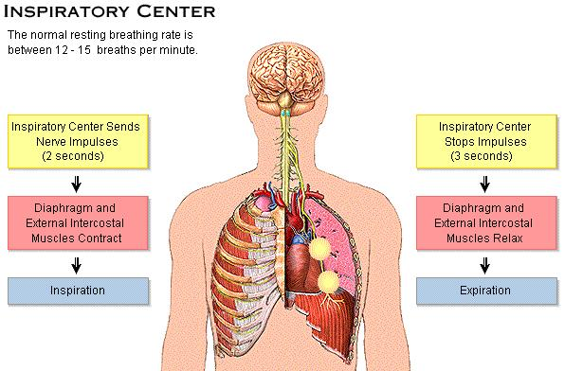
Notes:
Pneumotaxic center:
It is situated in upper Pons.It is formed by nucleus parabrachialis.Function: it controls medullary respiratory centers, particularly the inspiratory center through apneustic center. It always controls the activity of inspiratory center so that duration of inspiration is controlled.Apnuestic center:It is situated in lower Pons.Function: this center increases depth of inspiration by acting directly on the inspiratory center.

Slide 11
Pathway for normal quiet breathing
Respiratory centre in MEDULLA
↓
Somatic motor neurone pathways in anterior white matter of the spinal cord
↓
Respiratory muscles (diaphragm and external intercostal muscles)
↓
Rhythmical breathing

Slide 12
Pneumotaxic centre
Periodically inhibits inspiration
Helps is switching between inspiration and expiration
Acts as the inspiratory cut off switch
↑ activity →↑ respiratory rate
Damage results in:
increased tidal volume
reduced respiratory rate

Slide 13
Vagi
Stretch of the lungs during inspiration send impulses in afferent pulmonary vagal fibres
Inhibits inspiratory discharge
Damage :
Increased tidal volume
Reduced respiratory rate - prolonged inspiratory spasms
Mediate cough, mucus production, bronchoconstriction and rapid shallow breathing

Slide 14
Apneustic centre
Activation prolongs inspiratory signal leading to a long inspiration
“Apneusis” means sustained inspiration
Activity seen only if vagal afferents & pneumotaxic centre activity are stopped

Slide 15
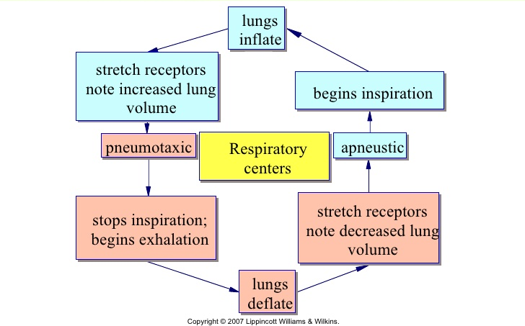

Slide 16
Respiratory rhythm
Medullary respiratory rhythm produces an irregular gasping breathing -crude pattern
Pontine centre and vagal influence serve to smoothen the rhythm

Slide 17
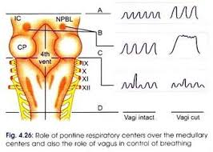
Influence of Vagal afferents and brain Influence of Vagal afferents and brain stem centres on the respiratory rhythm

Slide 18
Reflex control of breathing
Chemoreceptor reflexes
Mechanoreceptor reflexes

Slide 19
Chemoreceptor reflexes
Chemical control of breathing is a negative feedback system
Monitors arterial blood levels of O₂, CO₂ and H⁺
Causes reflex changes in ventilation that keep arterial blood gases at a normal level

Slide 20
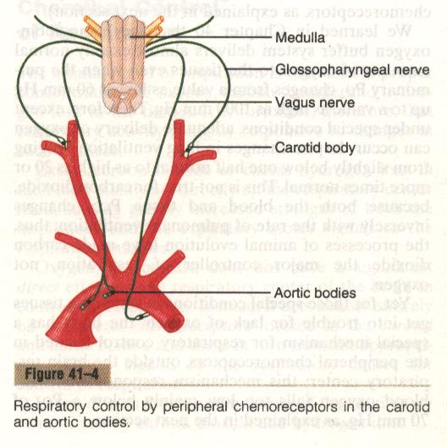
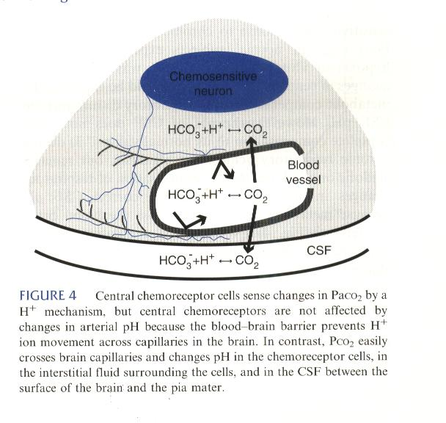
Sensors – Chemoreceptors
Central chemoreceptors
located on the ventral surface of the medulla in the floor of IVth ventricle
not a part of the respiratory centres
Peripheral chemoreceptors in the carotid and aortic bodies

Slide 21
Central chemoreceptors
Have chemosensitive neurons sensitive to changes in PCO₂
CO₂ moves into cells and generates H⁺ inside the chemosensitive cells, in ECF and CSF
Blood brain barrier prevents H⁺ going across it
Therefore changes in arterial pH are not sensed by central chemoreeptors

Slide 22
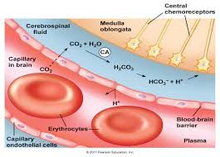

Slide 23
Peripheral chemoreceptors
Receptors - free nerve endings
Carotid bodies – afferents via glossopharnygeal nerves
Aortic bodies – afferents via vagus nerves
Carotid bodies are functionally more important than aortic bodies
Stimuli are changes in H⁺ , PaCO₂, PaO₂ levels
Have the highest blood flow per unit mass: ↑ efficiency

Slide 24
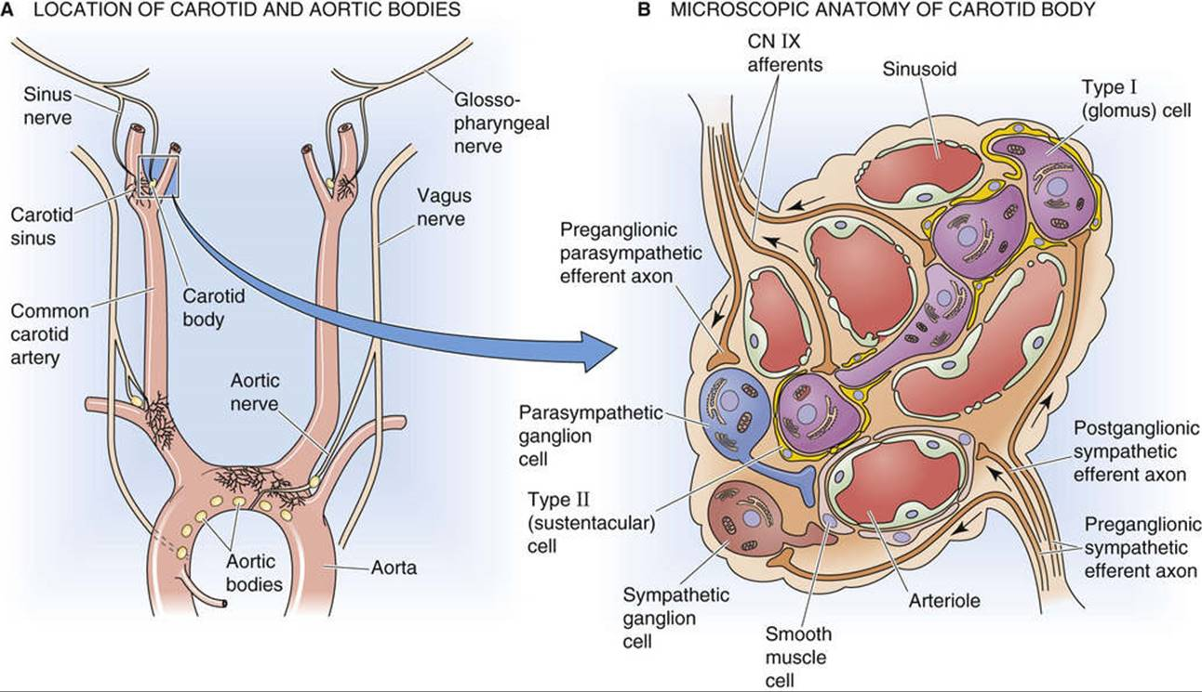

Slide 25
Response to arterial H⁺ concentration
Increase in arterial H⁺ concentration mainly stimulates peripheral chemoreceptors to increase ventilation
H⁺ do not readily cross blood-brain barrier
Eg-Lactic acids

Slide 26
Response to PaCO₂
Increase in PaCO₂ stimulates both central and peripheral chemoreceptors to increase ventilation
Central chemoreceptors are more sensitive
Account for >80% of CO₂ drive

Slide 27
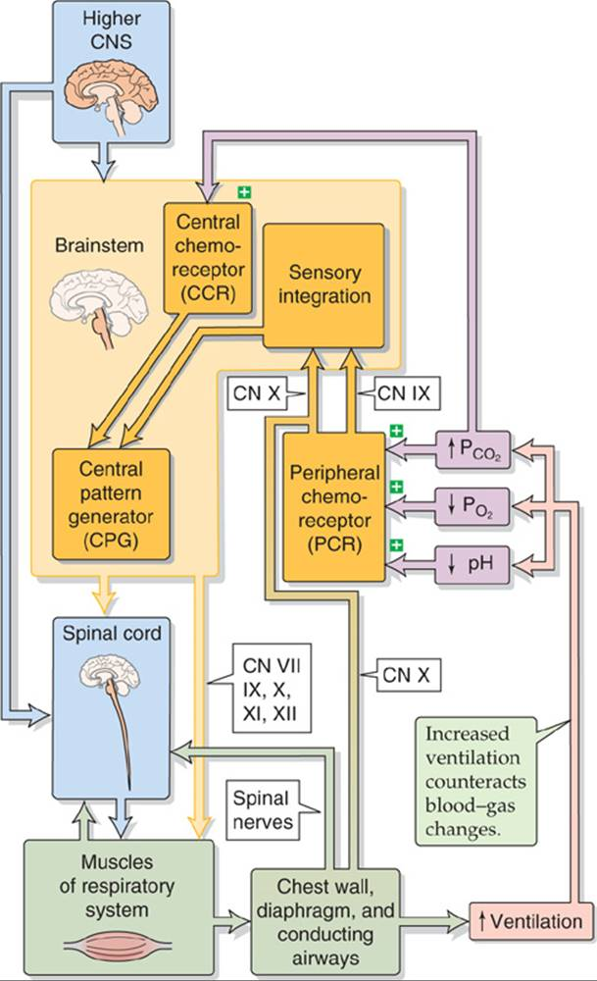

Slide 28
Response to PaO₂
Decrease in PaO₂ causes increase in ventilation through peripheral chemoreceptors
Peripheral chemoreceptors respond mainly to changes in dissolved oxygen
Removal of carotid bodies results in a loss of hypoxic response but hypercapnoeic response is only reduced

Slide 29
Response to O₂ lack continued……….
Discharge of peripheral chemoreceptors start as soon as P_{O2} drops below 100mmHg
But ventilation increases significantly only when P_{O2} ≤ 60 mmHg
Initial increase in ventilation is suppressed, as increase in ventilation flushes out CO₂ and lowers PaCO₂

Slide 30
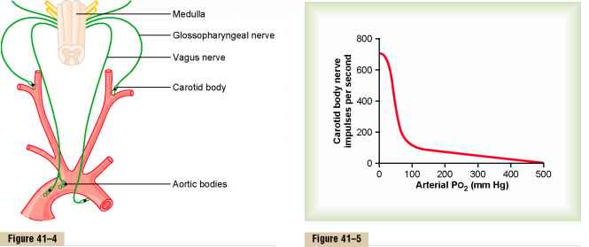
Peripheral chemoreceptor response to oxygen lack….
PO₂ of 60 mmHg

Slide 31
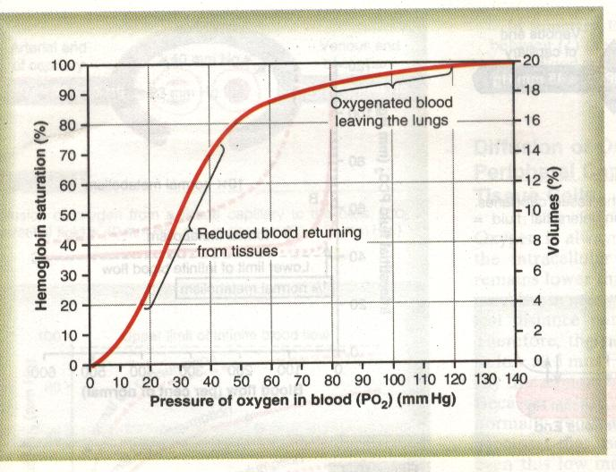
PaO₂<60mmHg
Point at which ventilation is increased significantly
Also the the point that Hb-O₂ starts decreasing significantly

Slide 32
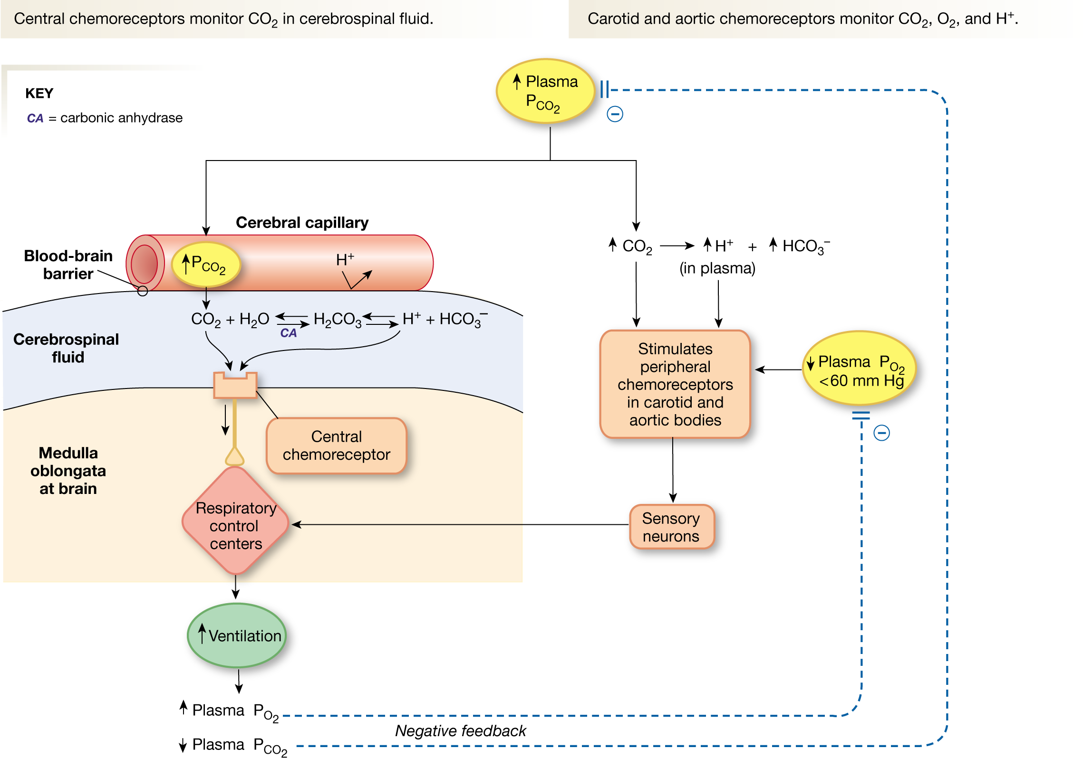

Slide 33
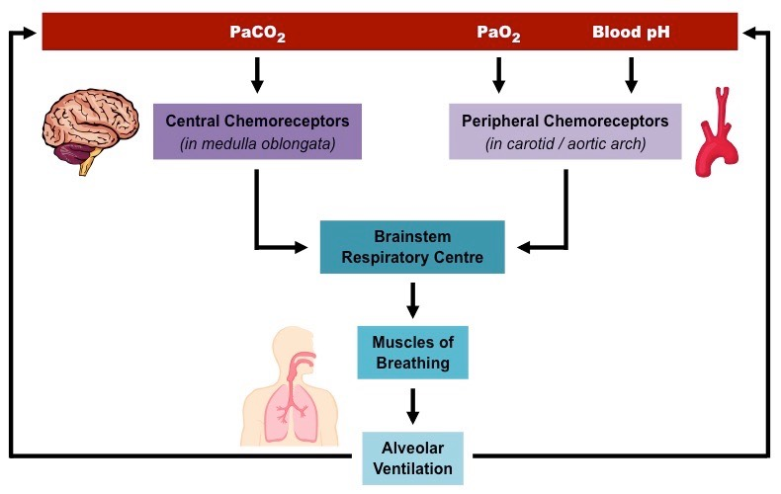

Slide 34
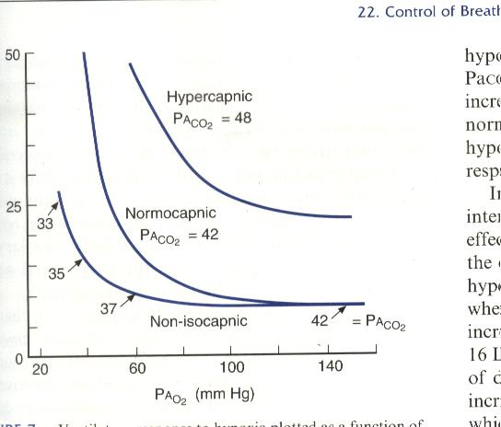
Ventilatory response to oxygen and carbon dioxide
Synergistic effect of PCO₂ & PO₂
Ventilatory response

Slide 35
Let’s consider some situations……
At rest drive to breathing is carbon dioxide
In metabolic acidosis
e.g. Diabetic ketoacidosis the drive is a rise of H⁺
In chronic hypoxia : a hypoxic drive occurs
Treatment with oxygen therapy may cause cessation of breathing or “apnoea” by removing hypoxic drive

Slide 36
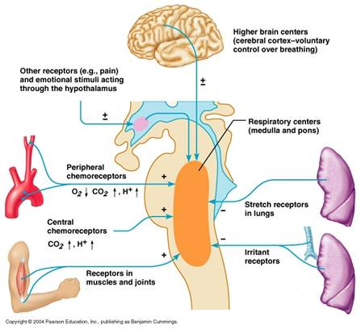

Slide 37
Summary
Normal rhythmic breathing is involuntary
Normal breathing is driven by the CO₂ drive
Originates in medullary respiratory centre
Influenced by pons, vagi, cortical control
Subject to reflex modifications : chemical control – changes in PaO₂, PaCO₂ and H⁺
Peripheral chemoreceptors mainly respond to changes in PaO₂
Central chemoreceptors mainly respond to changes in PaCO₂

Slide 38
Regulation of respiration II

Slide 39
Mechanical reflexes
Reflexes from upper airways protect lungs from injury
Pulmonary reflexes adjust frequency & tidal volume to stabilize ventilation
Vagus is nerve is afferent for most (except nasal receptors where afferent is trigeminal nerve)

Slide 40
Nose & upper airways
Receptors: mechano-receptors & chemo-receptors
Afferent : trigeminal nerve
Sneeze reflex
Deep inspiration followed by a forced expiration against an open glottis
Diving reflex
apnoea, laryngeal closure & bronchoconstriction, slows heart rate & diverts blood flow to vital organs
helps conserve O₂ supply

Slide 41
Epi-pharynx & pharynx
Sniff reflex
stimulated by mechanical irritation
sniffs push material down into pharynx to be coughed out or swallowed
Swallowing reflex
mechanoreceptor stimulation
inhibits inspiration, closes larynx, tongue pushes food down

Slide 42
Larynx
Cough reflex
Mechano- & chemo-receptor stimulation
Liquid stimulates apnoea

Slide 43
Lungs & lower airways

Slide 44
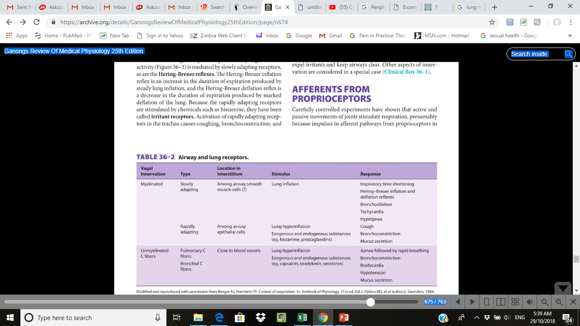

Slide 45
Receptors that influence ventilation
Pulmonary stretch receptors in tracheobronchial tree and alveolar walls
Lung irritant receptors in epithelial lining of tracheobronchial tree
Proprioceptors in limb joints
Arterial baroreceptors
Receptors in muscle spindles

Slide 46
Pulmonary stretch receptors Hering-Breuer reflex
Inflation of lungs
Stimulates pulmonary stretch receptors
Stimulates afferents in vagus nerves
Inhibit inspiratory centre in medulla
Cut off inspiration
Reduces rate and depth of breathing
Operates below a tidal volume of 1L
Protects lung from overinflation

Slide 47
Irritant(rapidly adapting) receptors located between epithelial cells of bronchi & bronchioles
Afferents in vagus nerves
Stimuli - hyperinflation, dust, chemicals, histamine, prostaglandins
Actions –
hyperpnoea
initiate cough reflex
bronchoconstriction
Not important in normal breathing but may have a role in Asthma

Slide 48
J - receptors (unmyelinated fibers) - located in alveolar walls adjacent to pulmonary capillaries
Afferents in vagus nerves
Stimuli - Interstitial space distortion
Actions:
Rapid shallow breathing “dyspnoea”
Also cause bronchoconstriction, hypotension & bradycardia
Not important in normal breathing
? Role in producing dyspnoea in left ventricular failure

Slide 49
Other afferents
From muscle spindles
Influences breath to breath volume changes
From proprioceptors in tendons & joints -
Not important in quiet breathing but have a role in the early ventilatory response to exercise
From arterial baroreceptors -
Account for the decrease in ventilation as blood pressure rises (minor effect)

Slide 50
Other afferents – contd.
Non-specific afferents from the Ascending reticular formation
Account for the changes in breathing during sleep
Non-REM sleep - irregular periodic breathing
REM sleep - irregular non-periodic breathing
Afferents from limbic system & hypothalamus (emotions & pain)
e.g. hysterical hyperventilation

Slide 51
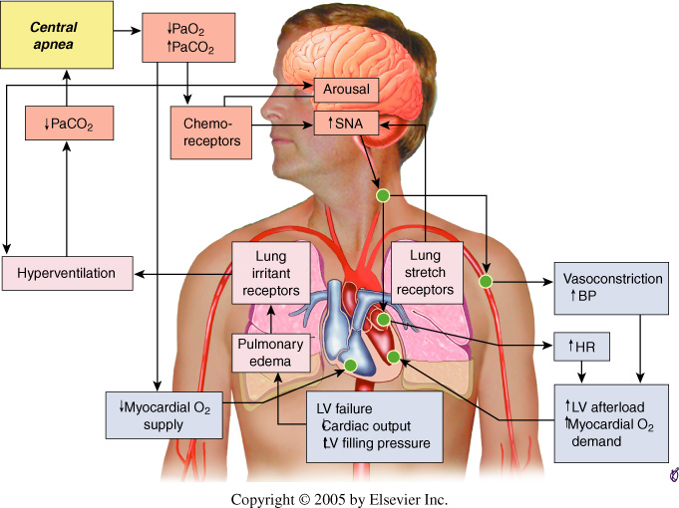

Slide 52
Voluntary control of breathing Due to direct cerebral cortical influence on the spinal α motor neurons

Slide 53
Pathway for voluntary breathing
Cerebral cortex
↓
Corticospinal tract in lateral white matter of spinal cord
Bypasses respiratory centres
↓
Respiratory muscles
Breath holding ⇔ Hyperventilation

Slide 54
Voluntary Hyperventilation
results in a fall in PaCO₂ and [H⁺]
may lead to respiratory alkalosis & tetany, dizziness & fainting (due to cerebral arteriolar constriction)
followed by apnoea and irregular breathing until PaCO₂ comes back to normal

Slide 55
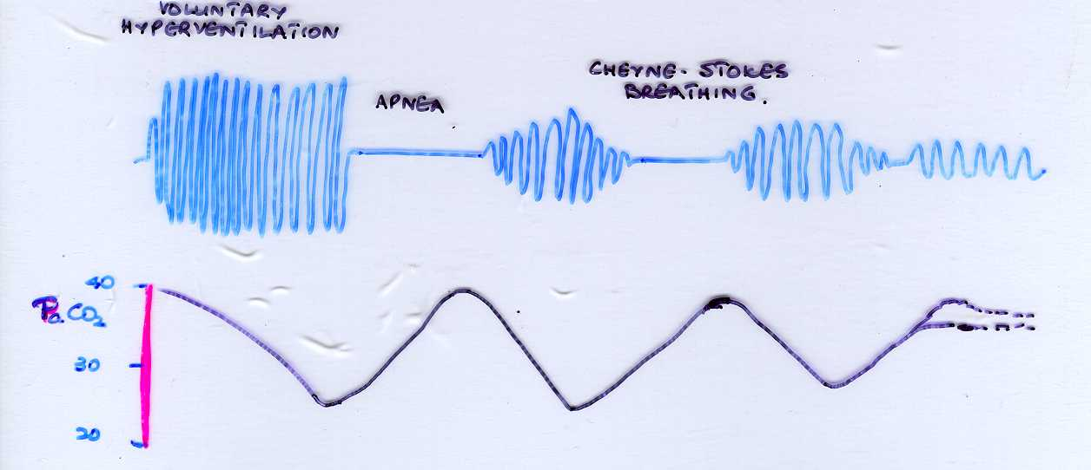
Effect of hyperventilation on breathing and PaCO₂

Slide 56
Breath-holding
Cortical signals inhibit spinal α- motor neurons
As breath is held ↑ PaCO₂, ↓PaO₂ and ↑[H⁺]
Stimulates
chemoreceptors
Stimulate
motor
neurons
Activity of
Respiratory centres
Terminates breath-holding (BREAKING POINT)
Hyperventilation or breathing oxygen rich mixtures
increases breath-holding time

Slide 57
Summary
Normal breathing is subject to
reflex modifications
mechanoreceptor reflexes
Herring Breur reflex
stretch, irritation, movement, changes in BP, emotions …
Voluntary control of breathing
Hyperventilation
Breath holding

Slide 58
https://www.youtube.com/watch?v=_lHOQyvWmnw

